Slide 1











ANDROID

Slide 2
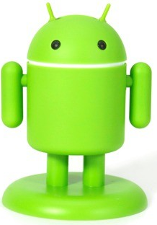
Why android named as “ANDROID”
?
ANDROID
A Robot With A Human Appearance

Slide 3
ANDROID INTRODUCTION
Open source operating system released under the Apache license.
Android is currently developed by the Open Handset Alliance and led by Google.

Slide 4
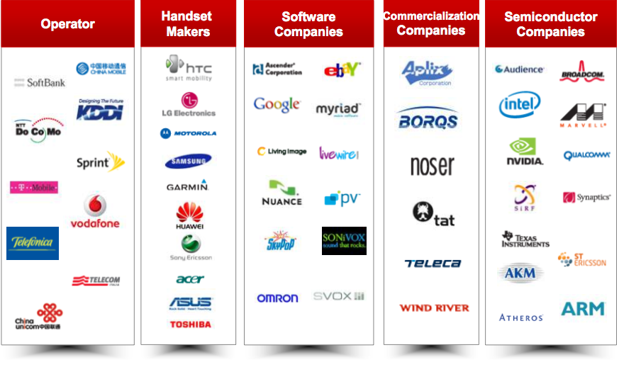
OPEN HANDSET ALLIANCE

Slide 5
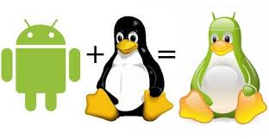
ANDROID INTRODUCTION
Android is Linux based (3.4 or 3.10) OS.
Provides more security
Memory management
Driver management, etc.

Slide 6
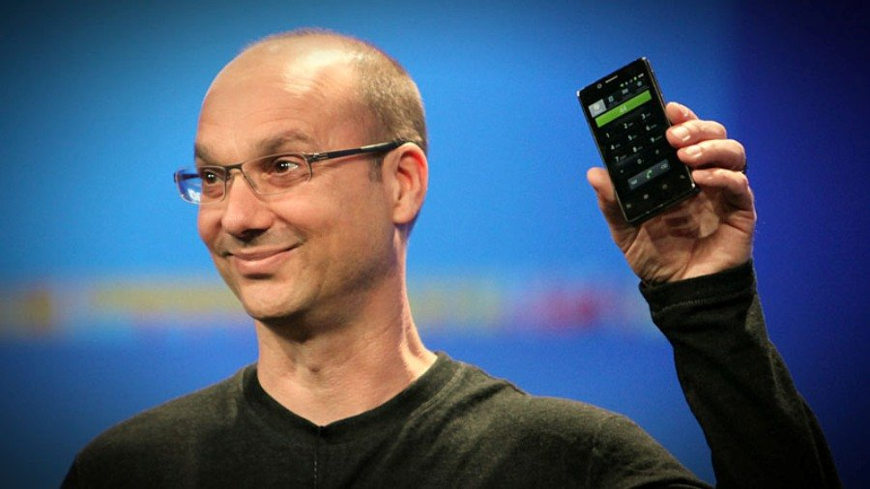
ANDROID HISTORY
Android, Inc. was founded in Palo Alto, California in October 2003 by Andy Rubin and his team.
Andy Rubin

Slide 7
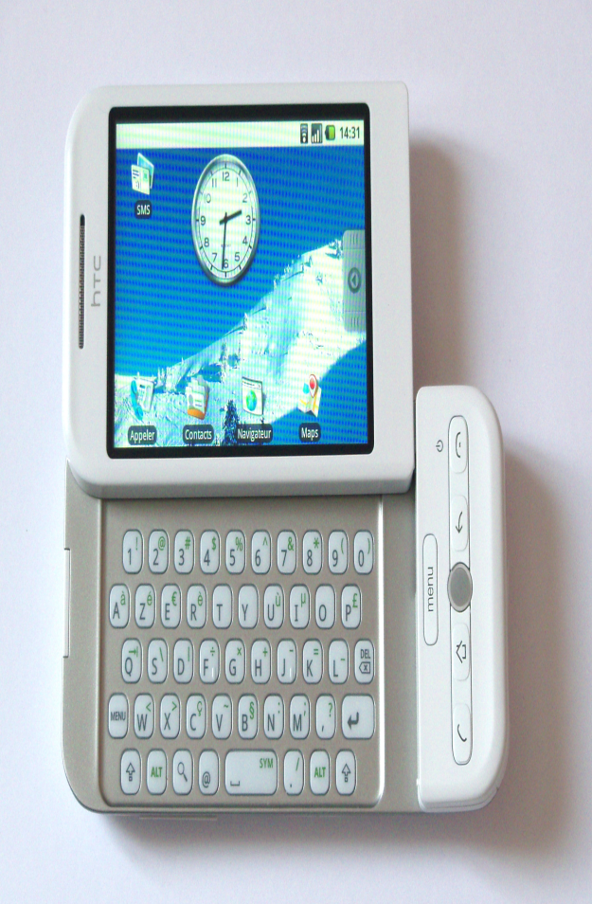
ANDROID HISTORY
In July 2005, Google acquired Android Inc. for at least $50 million.
HTC Dream

Slide 8
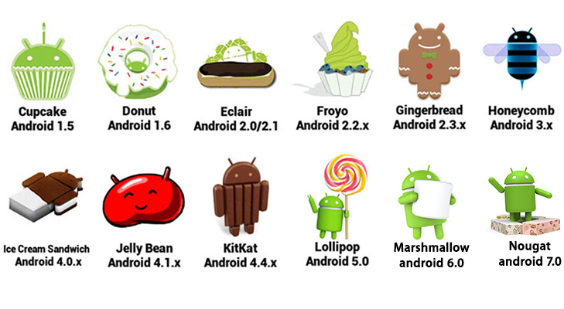
ANDROID VERSIONS

Slide 9
MISSING INITIAL VERSION
???
STARTING WITH
“A”
AND
“B”
???
Alpha
BETA

Slide 10
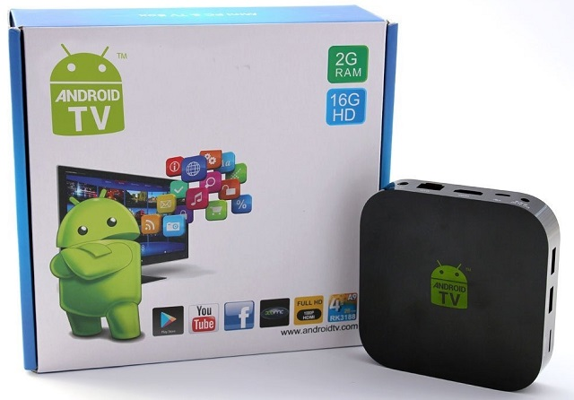
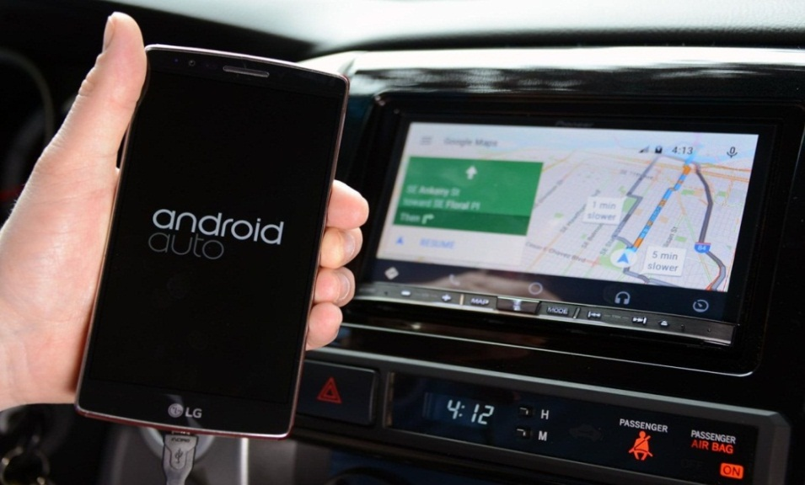
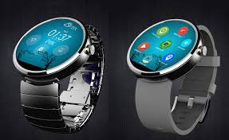
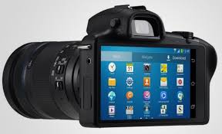
ANDROID FUTURE

Slide 11
ANDROID APPLICATION DEVELOPMENT
Android
SDK
Eclipse IDE
Android
Mobile
Device
Android
Emulator

Slide 12
ANDROID APPLICATION DEVELOPMENT
Android Studio
Android
SDK
Android
Emulator
Android Mobile Device

Slide 13
DOWNLOAD ANDROID STUDIO
Download Android Studio from:
https://developer.android.com/studio/index.html

Slide 14
ANDROID APPLICATION DEVELOPMENT
Java Source Code
Java Compiler
Java Byte Code
DEXER-Tool
Dalvik Byte Code
Java Virtual Machine
DVM

Slide 15
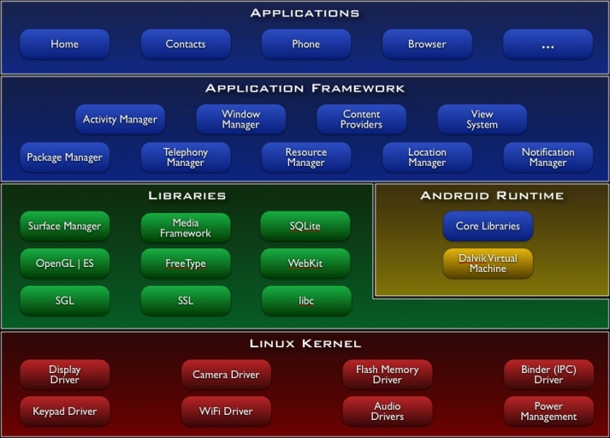
ANDROID ARCHITECTURE

Slide 16


BEFORE LOLLIPOP(5.0)
AFTER LOLLIPOP(5.0)
Android app
Android app
Use JIT(Just-In-Time) compilation.
Use AOT(Ahead-Of-Time) compilation.
JIT convert source code into native when app runs.
JIT reduces the installation time but user suffer with runtime performance.
AOT convert source code into native when app installs.
AOT increases the app runtime performance but deal with the installation time of app.

Slide 17
WITH NOUGAT (7.0)
Android app
No compilation at installation
Bring Profile-guided JIT/AOT Compilation.
ART maintains a profile of each app's hot methods and can precompile and cache those methods for best performance.
It does pre-compilation only when then the device is idle and charging.

Slide 18
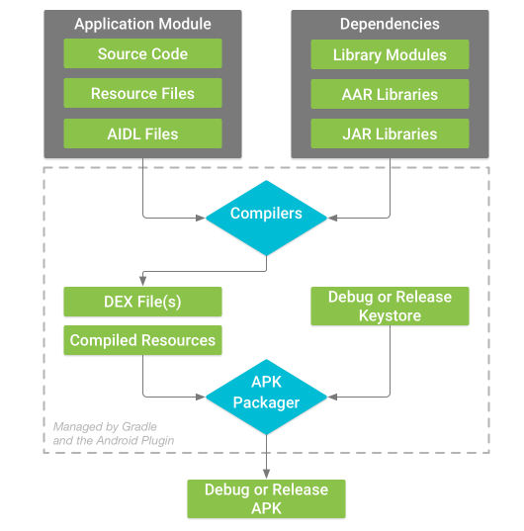
ANDROID PACKAGE BUILD PROCESS

